Slide 1


SAP UI5 & FIORI with OData TRAINING
Anubhav Oberoy
Day – 11

Slide 2
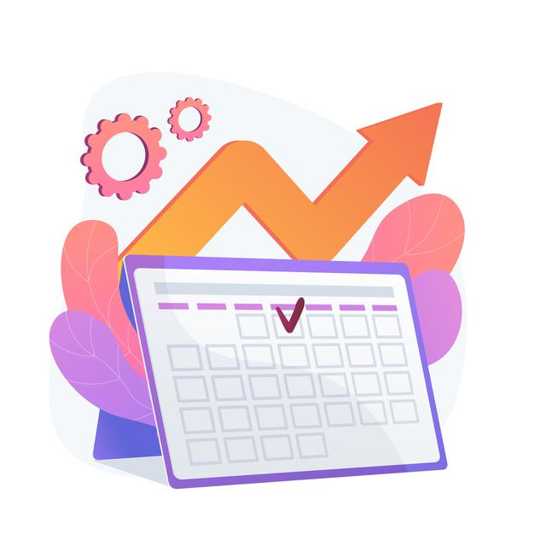
Agenda – Day 11
Adding toolbar in the application.
Showing a Message Box.
Introduction to Worklist Fiori Application
Icon Tab Bar and Icon Tab Filter
Drop Downs in ui5
Introduction ot Mater Detail Application
Introduction to Router and Routing
Understanding the use of Route Match Handler
Using SAP mobile table
Working with Messages in UI5
Introduction to Fragments in UI5
Understanding ways of using fragments
Using Fragments and Popup/Value Help
Basics of OData
Perform OData Calls on Northwind service
Introduction to Fiori System Architecture

Slide 3
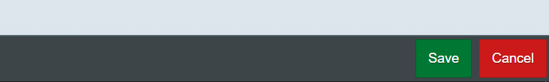
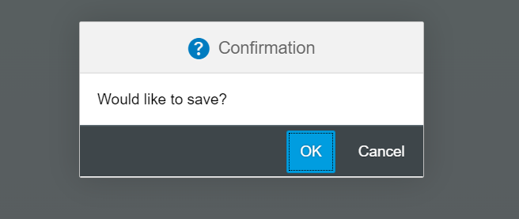
Exercise – Toolbar & Message Box
Toolbar:- A toolbar is a set of icons or buttons that are part of a software program's interface or an open window.
Toolbars have items such as Back and Forward buttons, a Home button, and an address field.
MessageBox: - The message box (sap.m.MessageBox) is a special dialog that allows you to display messages to the user. Compared to the message popover (sap.m.MessagePopover), you can use the message box to display messages that are not related to a field on the UI, such as technical errors.
In this exercise we will add a footer toolbar on the View2, in that toolbar we will also add to buttons and on click of that buttons we will open a MessageBox.
Exercise Code/Resource:
View2.view.xml
View2.controller.js
Header Toolbar
Footer Toolbar
Message Box

Slide 4
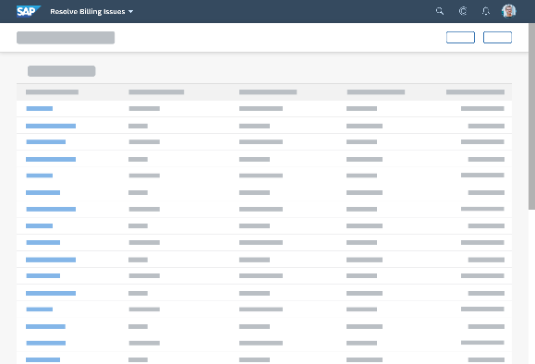
Introduction to Worklist Application
A worklist displays a collection of items a user needs to process. Working through the list usually involves reviewing details of the items and taking action. In most cases, the user has to either complete a work item or delegate it.
When to use:
Users have numerous work items and need to decide which ones to process first.
You want to give users a direct entry point for taking action on work items.
Users need to work with multiple views of the same content (for example, items that are “Open”, “In Process”, or “Completed”). You want to offer tabs for switching between views.
Detail View
List Page

Slide 5

Exercise: Work List Application
Now we will make over application a worklist application.
When we select a fruit in the list on the view1 the details of that fruit will be visible on the View2.
Exercise code/resources:
View1.view.xml
View1.controller.js
View2.view.xml

Slide 6
App
Split App Container
Master Pages
Detail Pages
V1
V2

Slide 7
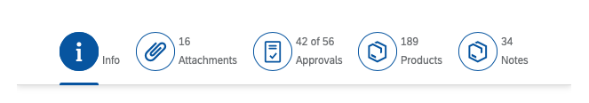
Icon Tab Bar and Icon Tab Filter
The icon tab bar comprises a series of tabs that each link to a different content area or view. You can use it for navigation within an object, or as a filter.
The IconTabBar represents a collection of tabs with associated content.
The IconTabFilter holds all information on an item - text, icon and count.
The IconTabBar can be used for navigation within an object, or as a filter. Different types of IconTabBar are used based on the contents.
Filter - There is only one main content for all tabs. The main content can be filtered, based on the selected tab.
Normal tab bar - The contents of each tab are independent from each other.
Combination of the above - There can be both filtered and independent contents.
There are two key use cases:
You want to let users navigate between different object facets in the object details area.
You want to let users filter lists, and give them the option of calling up the entire list, or only items with a specific attribute.
In both cases, the user switches between tab pages by clicking the respective tab.

Slide 8
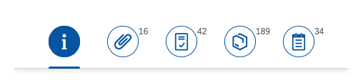

Exercise: Icon Tab and Icon Tab Filter Bar
In this exercise we will add a Icon tab bar in the fruit detail page. We will add three tabs in it as More Info, Supplier and Cities.
In More Info Tab we will add a Simple Form.
In Supplier Tab will add a empty table for now and in Cities tab a plain text field.
Exercise code/resources:-
View2.view.xml

Slide 9
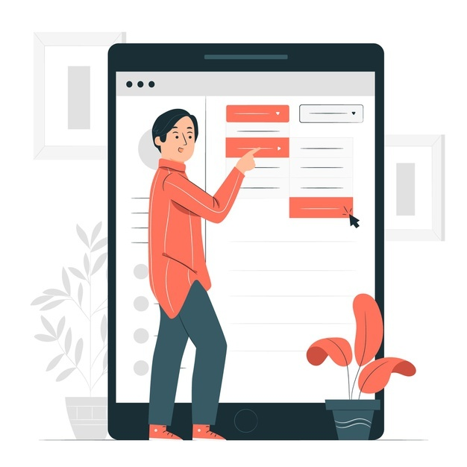
Exercise - Drop Downs in UI5
UI5 provides us different type of Dropdowns like Select box, ComboBox and MultiComboBox etc.
In this Exercise we will add there three controls in the Cities tab in View2 and bind these controls with our cities data model.
Exercise code/resources:
View2.view.xml

Slide 10
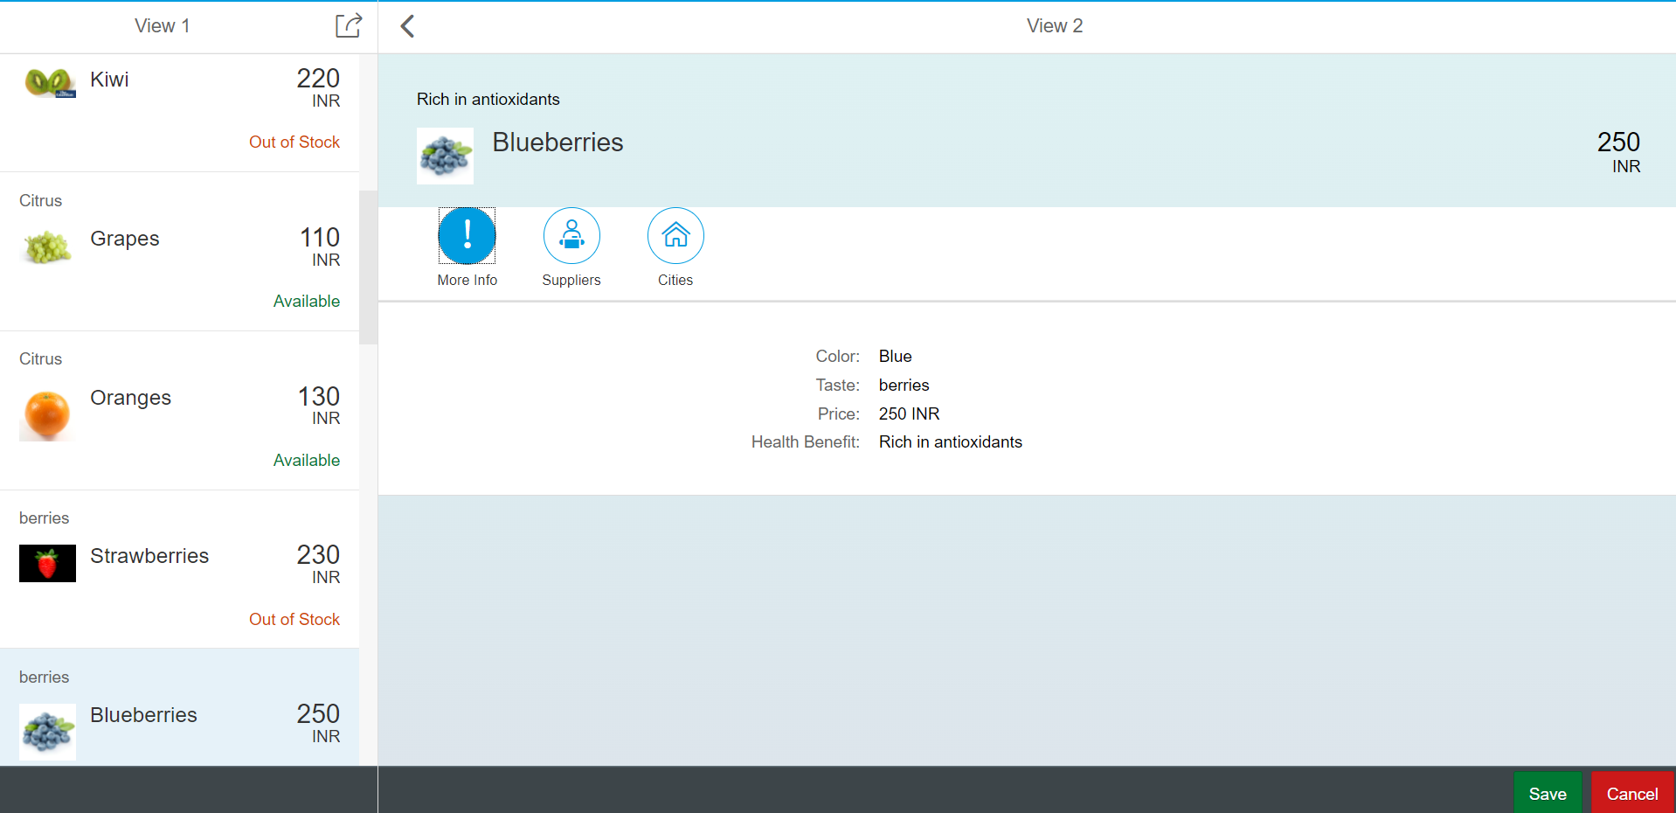
Introduction to master Detail Application
The SAPUI5 Master-Detail Worklist Application template implements a typical split-screen layout, one of the design patterns that is specified by the SAP Fiori Design Guidelines.
The split-screen layout is optimized for displaying and processing a list of items. On the left side of the screen, users can quickly scan and navigate through the list. On the right side, they then see the details of the selected item, and can trigger related actions or edit the data.
The main control of this app is the sap.m.SplitApp control that displays the Master view with a list of objects on the left side and the Detail view on the right side. When the user presses an object in the master list, the detail page is updated with the context of the selected item.
The Master view shows the current number of items and a search field that can be used to search through the list items. The number of items are updated automatically and the search filters for a preconfigured field of the list.
The Detail page contains a simple object header displaying more details for the selected object, an empty sap.m.IconTabBar that can be enriched with custom app content, and a table of line items that are associated to the selected object in the data model.

Slide 11
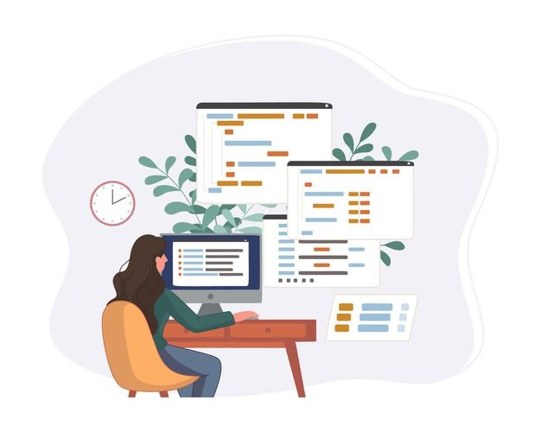
Exercise: Master Detail App
Now we will make our application a master detail Application. For this Exercise we will change our App view.
In app view instead for using App control we will use Split App control.
Exercise code/resources:-
App.view.xml
Component.js

Slide 12
Problem in our Fiori Like App - Navigation
When we press browser back and forward button, they should work correctly. Basically the back button should load the immediate back step just before navigation.
When a internet failure happens, before that we were at a particular state of the app and when app comes back online or refresh happens the app starts all over again, this will be annoying to user.
When we copy URL of our app and give it to someone, we were at a deeper navigation of an app. When we give the URL to them, it should reload the state of the application. Like AMAZON, FB PROFILE.
Instantiating view at the beginning is a high cost of memory consumption. When we go to a particular screen only then we need to create view object.
There is no standard followed to create view objects, each developer may write view codes inside different files eventually making is hard for fellow developers/successors to maintain the software.
The function to create view object sap.ui.view is deprecated.
A developer can create view objects in Fiori app at different places. This makes very hard for successor to take handover of these apps because they all are built differently eventually the same work. Missing standard.
All the view objects are created at once, there is no guarantee that a user will go to our view or not still we consume memory by creating them.
We have merged the code of one view inside another view, this brings tight coupling which makes it vary hard in future to decouple code and manage it.
I was reading online sap.ui.view is deprecated, why are we still using it, what is right way to create my view object.

Slide 13


Router and Routing
Router is a class provided by SAP and its object is readily available with the base class of Component. It will be responsible for creating our view objects as well as navigation of entire app. In past, we used to use event bus concept.
Steps :
We need to get the router object in Component JS from its base
Call initialize method using this object
The initialize method will SCAN manifest.json to find the routing configuration
Define the rootView configuration which will initialize our App.view.xml
Define the route configuration and targets to initialize and setup our navigation path between views
Router

Slide 14
Routing Configuration
Routing Configuration is defined in manifest.json file. It is defined under the “sap.ui5” section.
Routing configuration consists of routes, targets, config, and owner.
rootView
config
routes
targets
This section contains the information about our Root View. The View which works as a container for other views. In this section we provide the path of the view, type and controlId.
This section contains the global router configuration and default values that apply for all routes and targets. We define the router class that we want to use and where our views are located in the app.
Each route defines a name, a pattern, and one or more targets to navigate to when the route has been hit.
Three subsections :-
1. pattern
2. name
3. target
A target defines a view that is or more routes displayed, it is associated with one.
Subsections: -
Overview
detail

Slide 15
Navigation and Routing
Navigation and routing is essential in modern single-page applications such as apps built with SAPUI5.
In classical web applications, the server determines which resource is requested based on the URL pattern of the request and serves it accordingly. The server-side logic controls how the requested resource or page is displayed in an appropriate way.
In single-page applications, only one page is initially requested from the server and additional resources are dynamically loaded using client-side logic. The user only navigates within this page. The navigation is persisted in the hash instead of the server path or URL parameters.
Sap.m.routing.Router is the class used for Routing and Navigation purpose in SAP UI5 framework.
“Pattern” defines the hashtag that needs to be added at the end of the URL when it is hit.
“name” defines a unique name for the particular route.
“target” defines the target which is defined in targets section

Slide 16

Exercise: Routing
In this exercise we will add router to our application we will also see how to add routing configuration in the manifest.json file.
To Enable routing we have to initialize the router in Componenet.json file. Along with that we have to remove the Create content function form the Componenet.json file.
We will also add a new view in the application named as empty view.
For now we will implement the router without binding the view with the path.
Exercise code/resource:-
manifest.json
Component.js
View1.controller.js
Empty.view.xml
Empty.controller.js

Slide 17
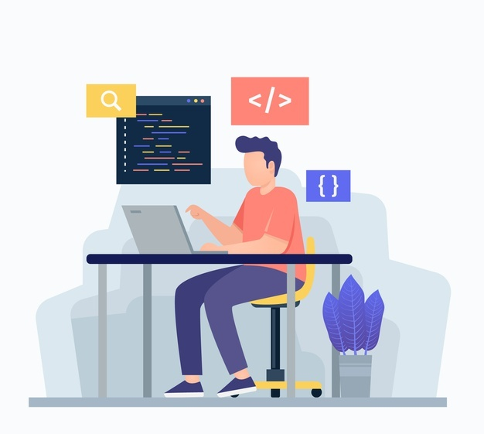
Route Match Handler
SAPUI5 offers a hash-based navigation, which allows you to build one-page apps where the navigation is done by changing the hash, so the browser does not have to reload the page. Instead there is a callback to which the app and especially the affected view can react. This callback is known as Route Match Handler.
Route Match Handler is called every time when the route is triggered.
Exercise code/resources:
View1.controller.js
View2.controller.js
manifest.json

Slide 18
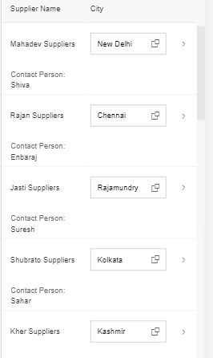
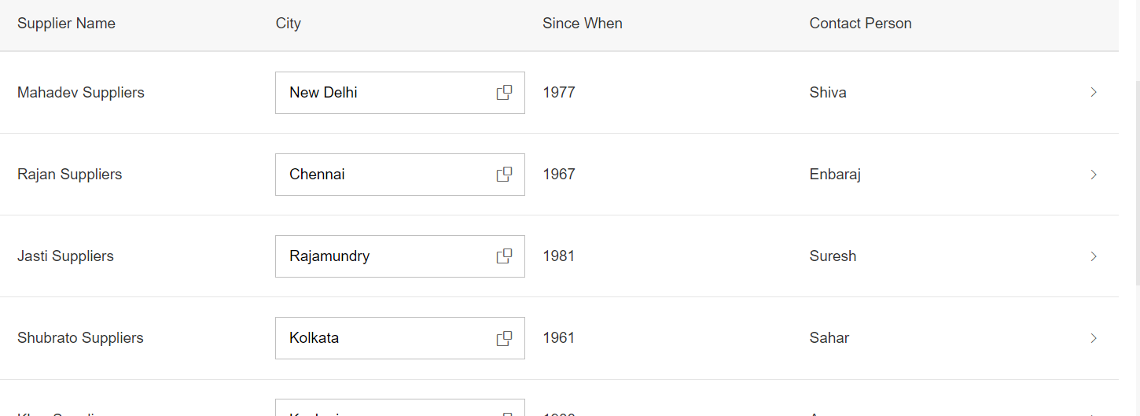
Working with Mobile Table
The responsive table is the default table in SAP Fiori. It contains a set of line items and is fully responsive. Depending on the scenario, users can also navigate from the line items to further details.
The responsive table is optimized for viewing one line item at a time with no scrolling or only vertical scrolling, irrespective of the display width.
On smartphones, only the most important data remains in the one-column or two-column table, while all other data is moved to the space between two item rows, known as the “pop-in area”.
In this area, data for the corresponding cell is provided as a label/value pair. The label is defined by the column header, and the value is taken from the corresponding cell. Labels can be displayed next to the value or above the value.

Slide 19
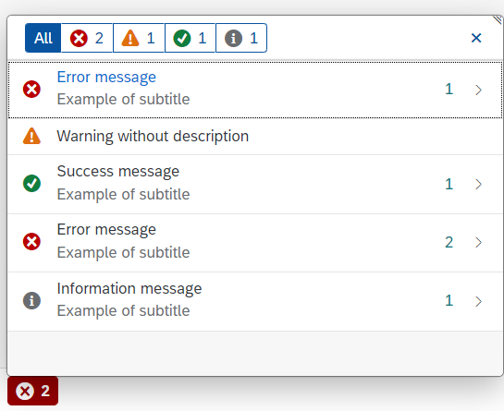
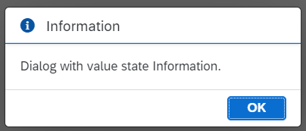
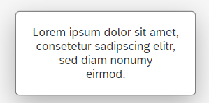
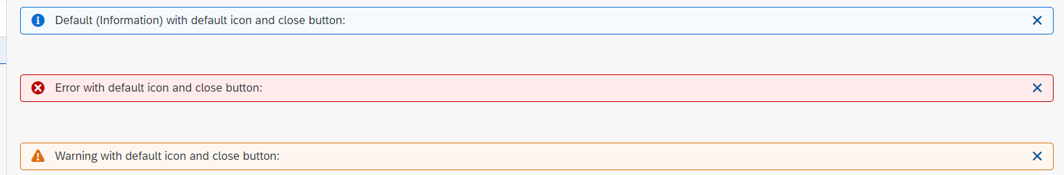
Working with Messages
The system generates messages in response to what users do in the SAP system. A message presents information, an instruction, or a warning to users in a given situation.
Messages can be used to notify the user about specific states of the application and can help the user to correct their incorrect inputs.
For showing messages to the user that are related to the current page, you have several possible controls. Each of these offers a different type of interaction from the user. Choose the control that fits best in you interaction pattern.
Message Dialog: A message dialog interrupts the user's workflow by blocking the current page and needs to be closed by the user.
Message Toast: A message toast is an overlay that disappears after some time or if the user taps somewhere else. It does not block the user.
MessageStrip: MessageStrip enables the embedding of short application-related messages in the application. There are four types of messages and each is color-coded and has an icon corresponding to its type: Information, Success, Warning and Error.
MessagePopover: MessagePopover displays a summarized list of different types of messages (errors, warnings, success and information). It provides a handy and systemized way to navigate and explore details for every message.

Slide 20

Exercise: Mobile Table and Message Toast
In this exercise we will add a Mobile table in the supplier section of the Icon tab bar. In the header of the Table we will add a filter button. On click of that button we will display a some messages.
Exercise code/resource:
View2.view.xml
View2.controller.js

Slide 21
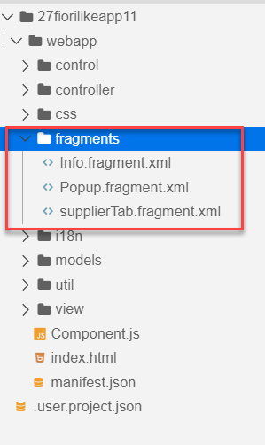
Fragments
Fragments are light-weight UI parts. They are used to modularize views. We can reuse a fragment multiple times in same view or other views.
This class acts as factory which returns the UI control tree defined inside the Fragments.
Fragments are used similar as sap.ui.core.mvc.Views, but Fragments do not have their own controllers. Logic related to fragment’s UI elements is written in the host view’s controller.
Fragments are used similar as sap. ui.
Do not call the Fragment constructor directly!
Use-cases for Fragments are e.g.: - Modularization of UIs without fragmenting the controller structure - Re-use of UI parts - 100%- declarative definition of Views.
Constructor of Fragment is new sap.ui.core.Fragment()
View
View
Popup
Fragment
Popup
View
View
Popup

Slide 23
Loading Fragments in the View
There are two ways of loading filters in the view.
Including the fragment directly into the XML View using the sap.ui.core.Fragment class
Ex: <core:Fragment fragmentName="mynamespace.fragment.FragmentName" type="XML" />
Loading the fragment using the controller on an event. Like for Value Helps.
Steps to load the Fragment using the controller. (without using promise)
Frist we have to create a Fragment Object. To create the object we can use the following method.
var oFragment = sap.ui.xmlfragment(“id”, “namespace.fragment.FragmentName”, controllerObject);
Now Attach the fragment dependent to the view.
this.getView().addDependent(oFragment);
Now open the fragment.
oFragment.open();
Steps to load the Fragment using the controller (with promise).
First we need to include the Fragment dependency in the controller.
'sap/ui/core/Fragment’,
2. Load the fragment using the method
Fragment.load({id: ‘’, name: ‘’, controller: ‘’}).then(function(oFrag){
//code to open the fragment
});

Slide 24

Exercise: Fragments
Part 1: Loading the Fragment in XML View
In this exercise we will move the code in Icon tab bar to different fragments.
Then load those fragments directly into the XML view.
Exercise code/resource:-
View2.view.xml
Cities.fragment.xml
MoreInfo.fragment.xml
SupplierTab.fragment.xml
Part 2: In this part we will load the fragment form the controller.
Now we will make a new fragment for the Suppliers. This fragment will open when we click on the filter button as a value help.
Also we will filter the table according to the selected filter.
Also we will make a value Help for city in table.
Exercise code/resource:-
View2.controller.js
SupplierTab.fragment.xml
popup.fragment.xml

Slide 25
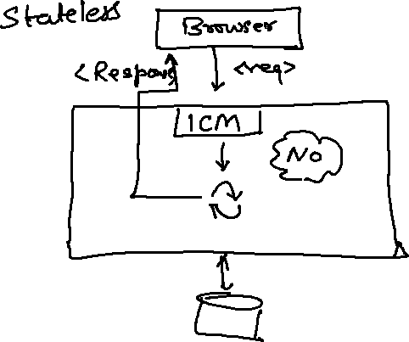
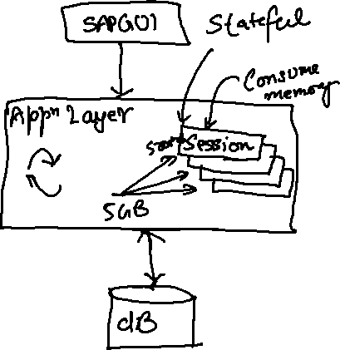
What is OData?
OData Stands for Open Data Protocol, it is an OASIS standard to communicate to server using REST based service. It was acquired by Microsoft in 2012 and adopted by many companies to build REST services to expose data over internet HTTP/HTTPs protocol.
Funda Fox
Fiori cannot talk to FM, program, CDS views, …. Fiori only and only talk to OData service which is built on top of FM, ABAP code, CDS view.

Slide 26
OData Basics
This OData Protocol is mainly used to expose data over HTTP. It does not matter from consumer point, which technology the OData is built on. This way we are abstracted from the underlaying programming/database. Fiori only and only understand OData, it cannot talk to BAPI, BADI, FM, CDS View, Interface, Class.
Lets start understanding a sample odata given by Microsoft on odata.org
1. Service document – is a collection of entity sets to access the data.
An Entity set is built by an Entity Type. Entity Set is the right end point to perform CURDQ operations
Entity Type describes the structure of the data – metadata
https://services.odata.org/V3/Northwind/Northwind.svc/
2. Service metadata document – describes all the properties and entity types
Which includes key, properties, attributes (nullable, key, max length, create), NavigationProperty
Also includes the relations between entities called association (compare with Foreign key)
Usually one database table is considered as one entity.
https://services.odata.org/V3/Northwind/Northwind.svc/$metadata
https://chrome.google.com/webstore/detail/jsonview/chklaanhfefbnpoihckbnefhakgolnmc
https://chrome.google.com/webstore/detail/xml-tree/gbammbheopgpmaagmckhpjbfgdfkpadb

Slide 28

Structure of an OData URL
http://stcfin.st.com:8021/sap/opu/odata/IWBEP/GWSAMPLE_BASIC/ProductSet?$format=json
http(s)://hostname:port/sap/opu/odata/sap/SERVICENAME_SRV/ENTITYSET?p1=val&p2=val
Protocol
Address & Port
Path prefix
Service Name
End Point Access Data
Query Options

Slide 29
Client Side Query with OData
Sets the page size of results.
02
$top
Indexes into a result set. Also used by some APIs to implement paging and can be used together with $top to manually page results.
Returns the results in the specified media format.
01
03
$format
$skip
ODATA Query
06
04
Retrieves related resources.
Filters properties (columns).
$expand
$select
05
$filter
Filters results (rows).

Slide 30
GET operations
Read All the data from Products (SELECT * FROM dbtab)
https://services.odata.org/V3/Northwind/Northwind.svc/Products?$format=json
Read few properties of entity (SELECT col1, col2 FROM dbtab)
https://services.odata.org/V3/Northwind/Northwind.svc/Products?$format=json&$select=ProductID,SupplierID
Read Top Records (Pagination SELECT * UP TO ROWS n ..)
https://services.odata.org/V3/Northwind/Northwind.svc/Products?$format=json&$top=3&$skip=10
Read data by filtering (SELECT * FROM dbtab WHERE condition)
https://services.odata.org/V3/Northwind/Northwind.svc/Products?$format=json&$filter=SupplierID%20eq%203
SELECT * FROM dbtab WHERE col LIKE ‘%pattern%’
https://services.odata.org/V3/Northwind/Northwind.svc/Products?$format=json&$filter=substringof(%27Cola%27,ProductName)%20eq%20true
Reading count of the records (SELECT COUNT(*) FROM dbtab)
https://services.odata.org/V3/Northwind/Northwind.svc/Products/$count
Reading Single record by its key (SELECT SINGLE * FROM edbtab WHERE pkey = ‘key’)
https://services.odata.org/V3/Northwind/Northwind.svc/Products(11)?$format=json
Join and read data together (SELECT * FROM tab1 INNER JOIN tab2 ON cond)
https://services.odata.org/V3/Northwind/Northwind.svc/Products(11)?$format=json&$expand=Supplier,Category

Slide 31
SAP Fiori System Architecture
Presentation Layer
SAPGUI/Browser
Presentation Layer
SAPGUI/Browser
Fiori Apps
[new]Fiori Frontend Server
Like a HUB/Switch
services
OData services publish
Embedded System (LOCAL)
Services, Reg.,Publish, Fiori Apps, Launchpad, Designer, Apps, Code, ABAP Code
Fiori launchpad
RFC(SM59)
Existing ECC/App Layer
Fiori Backend Server
SAP CRM
SAP PLM
Development of service code
SAP HCM
SAP SRM

Slide 32
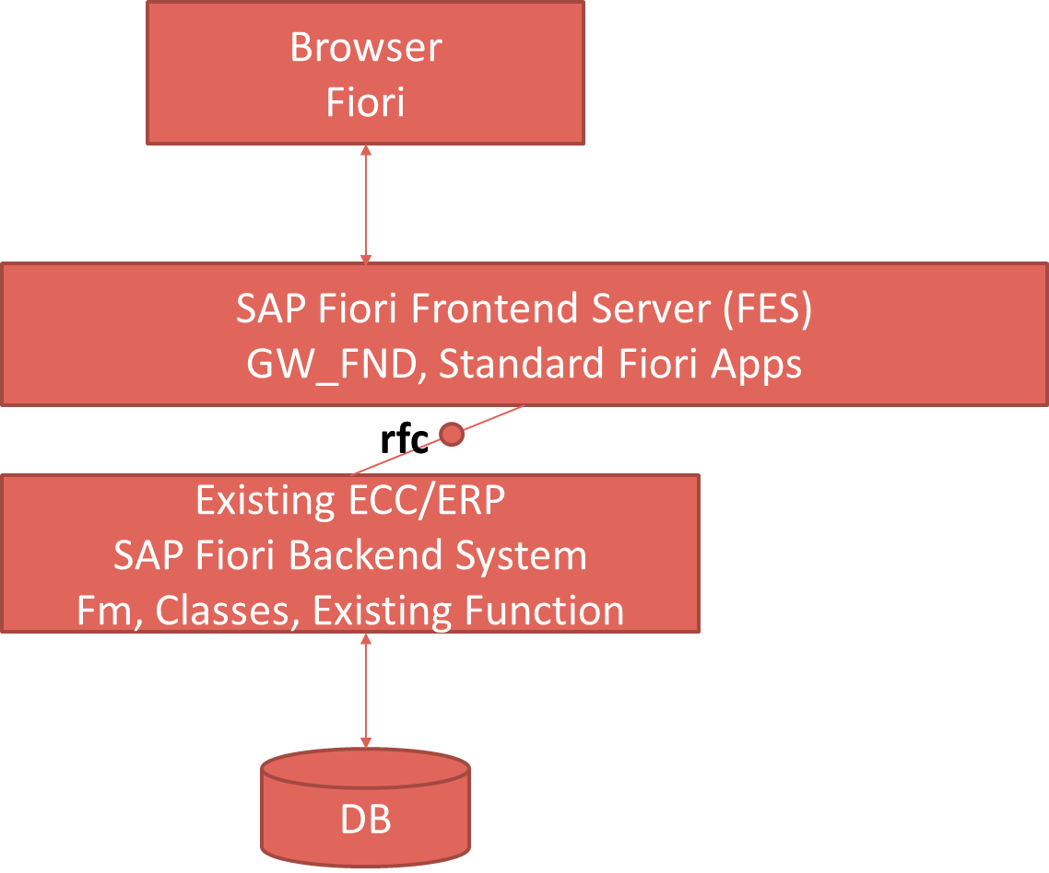
Pros and Cons
Central HUB Deployment
Cons:
Manage multiple systems
Cost is high
Confusion
User needs to be duplicated
OData Metadata is duplicate
Pros
No need to upgrade
Separation of concerns
Works like a HUB
Embedded Deployment (recommended)
Pros – Less Costly, no confusion, No redundancy
Cons – Upgrade
Recommendation
https://www.sap.com/documents/2018/02/f0148939-f27c-0010-82c7-eda71af511fa.html
S/4HANA
CRM

Slide 33

End of Day 11

Slide 34

Questions

Slide 35

Anubhav Oberoy

Slide 36


We’re committed to empower you to be
Most Desirable Resource
through powerful training solutions.
We build the workforce of the future.
250+
Corporate Clients
30,000+
Learners Trained
25000+
Learners Placed
FREE WEBINARS
Sign up for free webinars with industry experts every fortnight!
Enroll Now!
Contact us today!
https://anubhavtrainings.com/

Slide 37




More from AnubhavTrainings.com

Slide 38
Title
Content

